Slide 1
Credit Risk Assessment with Machine Learning
Bridging the Gap Between Theory and Practice

Slide 2
Introduction
Importance of accurate credit risk assessment.
Consequences of misestimation.
Two-fold aim of the study.
Photo by Pexels

Slide 3
Problem Statement & Motivation
Objective: Develop a reliable method for classifying credit risk.
Importance for financial institutions.
The necessity of understanding and predicting credit risks for economic stability.
Machine learning's role in refining lending decisions
The need for an unbiased exploration of machine learning capabilities.
Evaluation and contrast of models like K-Nearest Neighbors, Logistic Regression, Decision Trees, and Neural Networks
Photo by Pexels

Slide 4
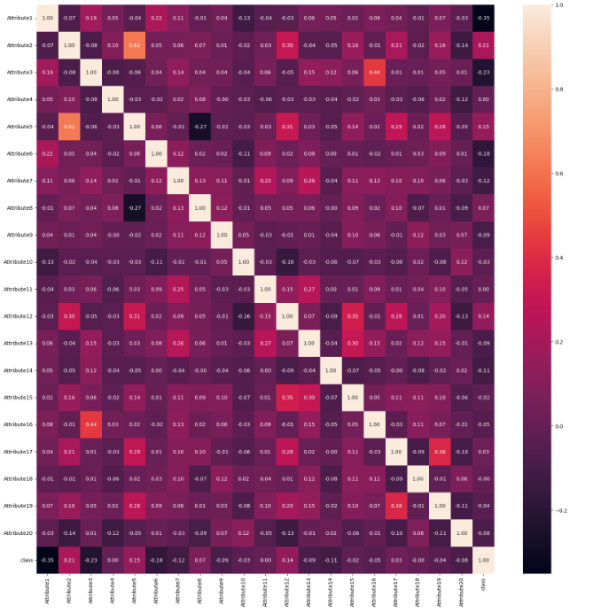
Components, Methodologies & Limitations
Data Collection & Preprocessing
Model Development & Implementation
Performance Evaluation
Comparative Analysis
Data Constraints
Model Bias & Overfitting
Complexity of Financial Behaviors
Dynamic Financial Environment
Photo by Pexels

Slide 5
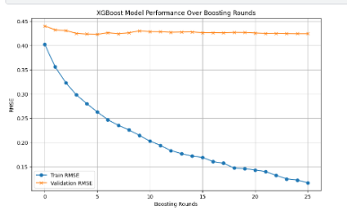
XGBoost Performance
Performance of the XGBoost model
Progressive decrease in training and validation RMSE
Number of boosting rounds vs. accuracy and generalization
Convergence of training and validation RMSE
Optimal balance between overfitting risk and predictive power
Photo by Pexels

Slide 6
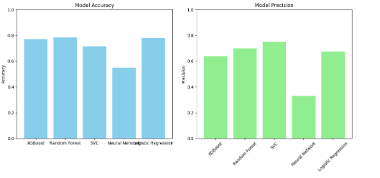
Model Comparisons
Accuracy and precision of various models
Comparison of XGBoost, Random Forest, SVC, and Logistic Regression
Superior performance of XGBoost and Random Forest
Effectiveness of ensemble methods in credit risk data
Photo by Pexels

Slide 7
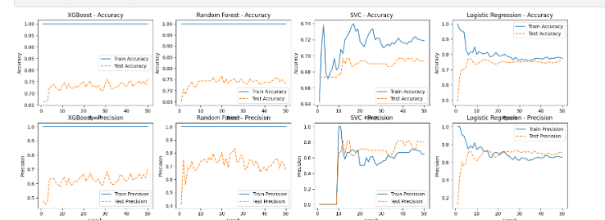
Performance & Precision over Rounds
Multi-faceted view of model accuracy and precision
Consistent performance of XGBoost and Random Forest
Stable accuracy and precision across evaluation rounds
Contrast with SVC and Logistic Regression models
Photo by Pexels

Slide 8
Conclusions
Understanding the Importance of the correlation matrix in feature selection.
Superiority of XGBoost and Random Forest models.
Contributions of the project to credit risk analysis.
Highlighting the challenges and future research directions.
Photo by Pexels

Slide 9
References
Shi, S., Tse, R., Luo, W., D’Addona, S., & Pau, G. (2022). Machine learning-driven credit risk: a systemic review. Neural Computing and Applications, 34(17), 14327–14339. https://doi.org/10.1007/s00521-022-07472-2
Bitetto, A., Cerchiello, P., Filomeni, S., Tanda, A., & Tarantino, B. (2023). Machine learning and credit risk: Empirical evidence from small- and mid-sized businesses. Socio-Economic Planning Sciences, 90, 101746. https://doi.org/10.1016/j.seps.2023.101746
Bussmann, N., Giudici, P., Marinelli, D. et al. Explainable Machine Learning in Credit Risk Management. Comput Econ 57, 203–216 (2021). https://doi.org/10.1007/s10614-020-10042-0
Wang, Y., Zhang, Y., Lu, Y., & Yu, X. (2020). A Comparative Assessment of Credit Risk Model Based on Machine Learning — a case study of bank loan data. Procedia Computer Science, 174, 141-149. https://doi.org/10.1016/j.procs.2020.06.069
Photo by Pexels

Slide 10
Thank You

Slide 11
Any Questions ?

